Slide 1
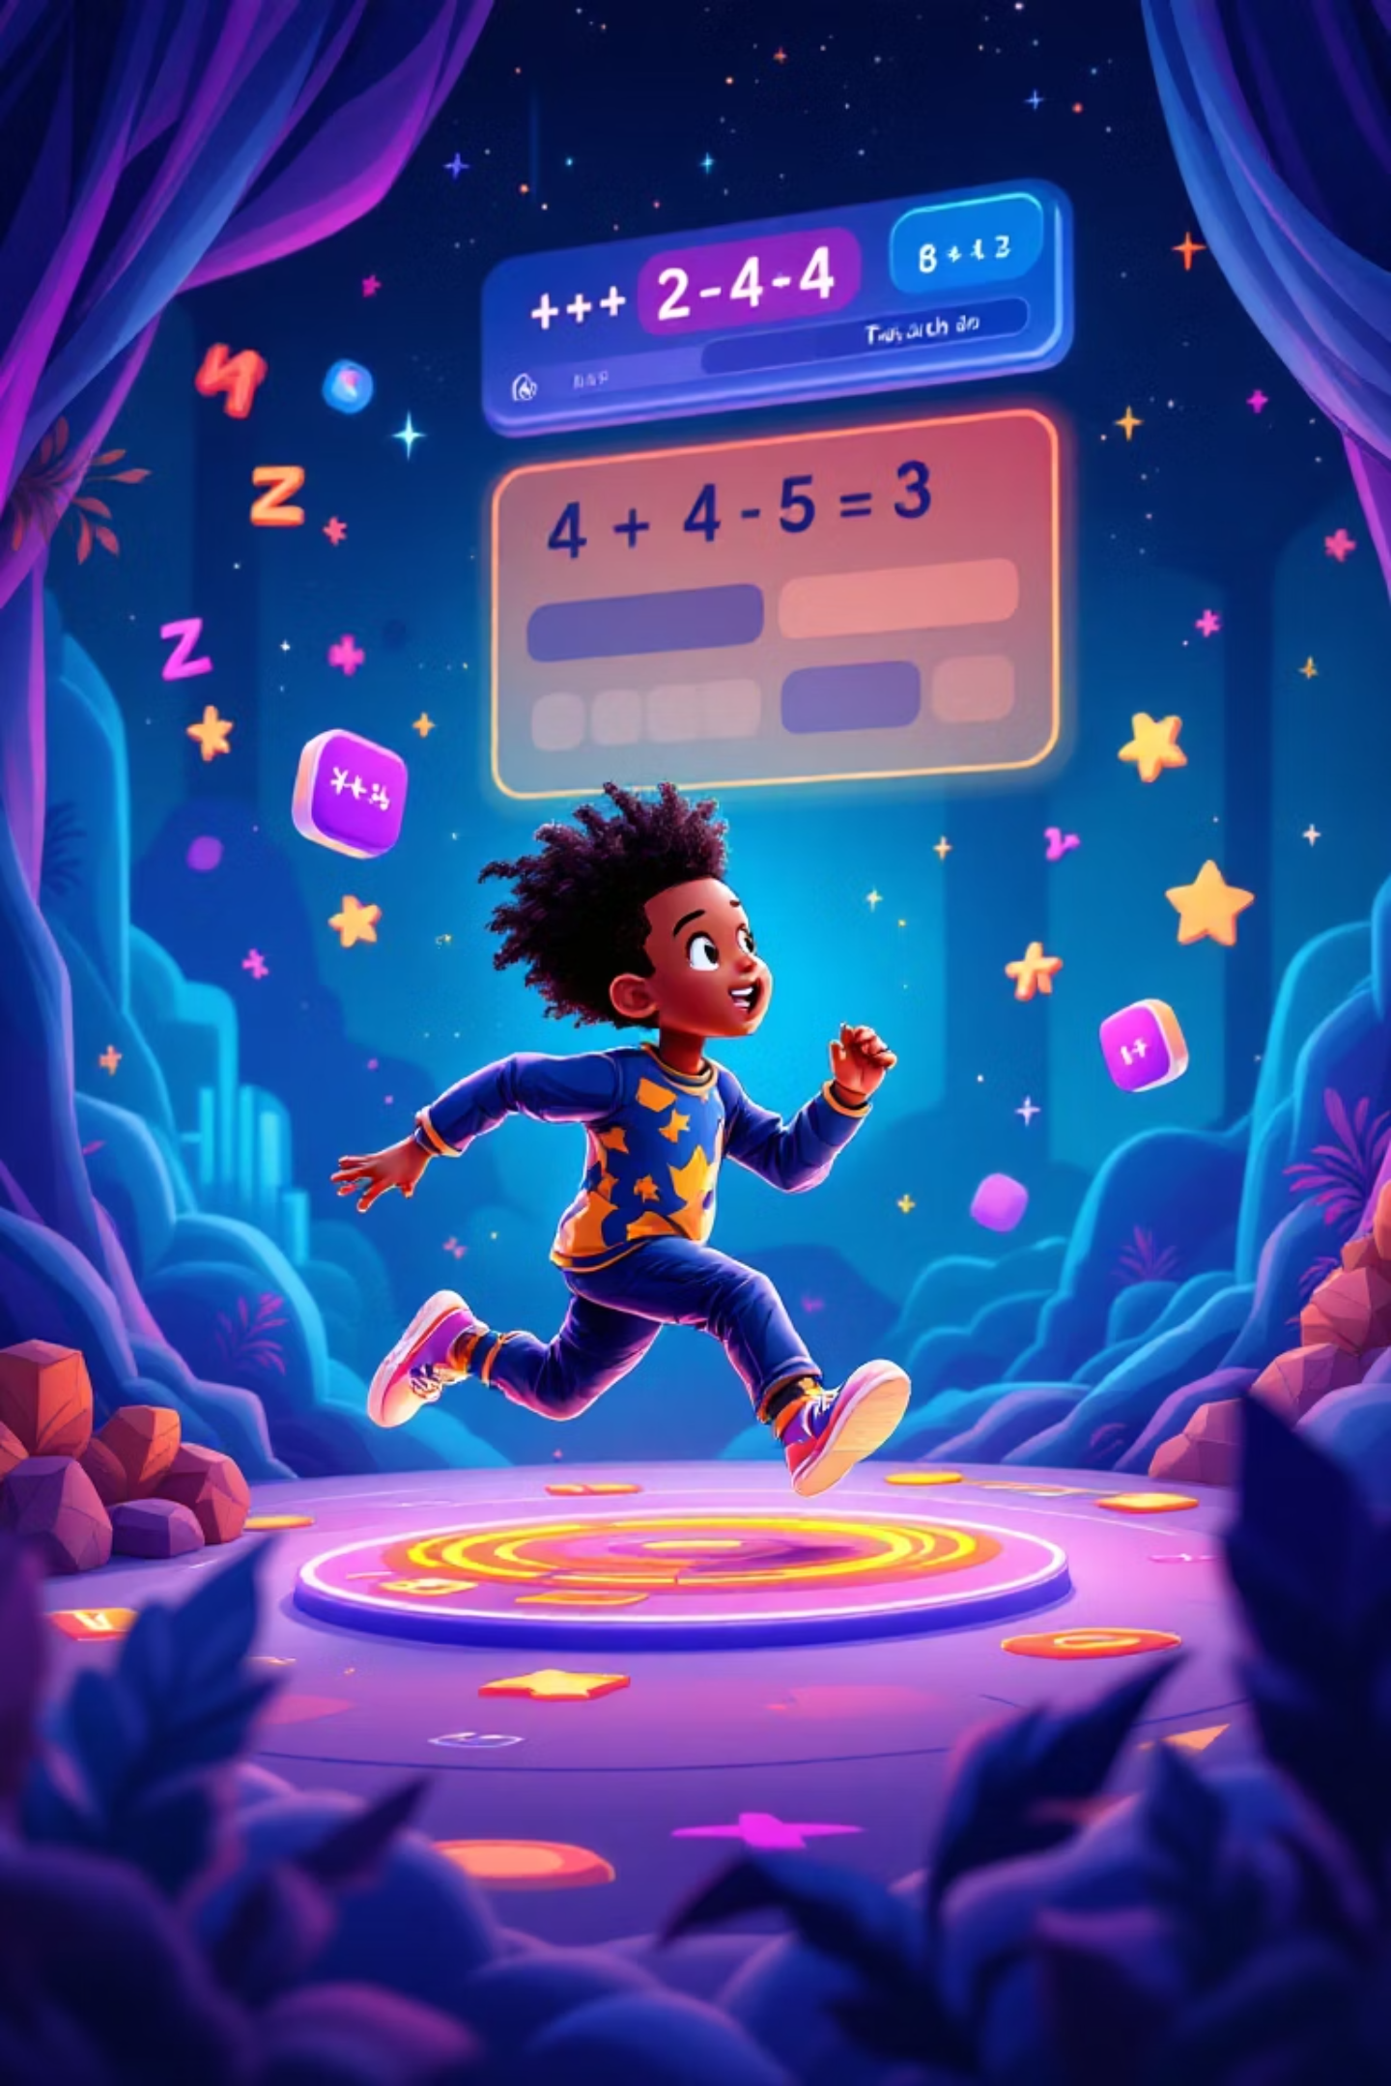
Math Runner
Educational game combining mathematics learning with engaging runner-style gameplay mechanics.

Slide 2

Project Vision
Target Audience
Core Concept
Students from elementary to high school levels seeking interactive math practice.
Players solve math problems to overcome obstacles and defeat enemies while running.
Educational Goal
Make mathematics fun and accessible through gamified learning experiences.

Slide 3



Key Stakeholders
Primary Users
Educators
Development Team
Students and players across various education levels seeking engaging math practice.
Teachers looking for classroom integration tools to enhance math instruction.
Student developers building the game using Python and Pygame frameworks.

Slide 4

Core Game Mechanics
01
02
Level Selection
Side-Scrolling Action
Players choose education level: elementary arithmetic, middle school algebra, or high school calculus.
Character automatically runs forward through dynamic environments with obstacles and enemies.
03
04
Math Challenges
Scoring System
Pop-up questions appear when approaching barriers. Correct answers enable progression.
Points awarded for correct answers, speed, and combo streaks with unlockable levels.

Slide 5
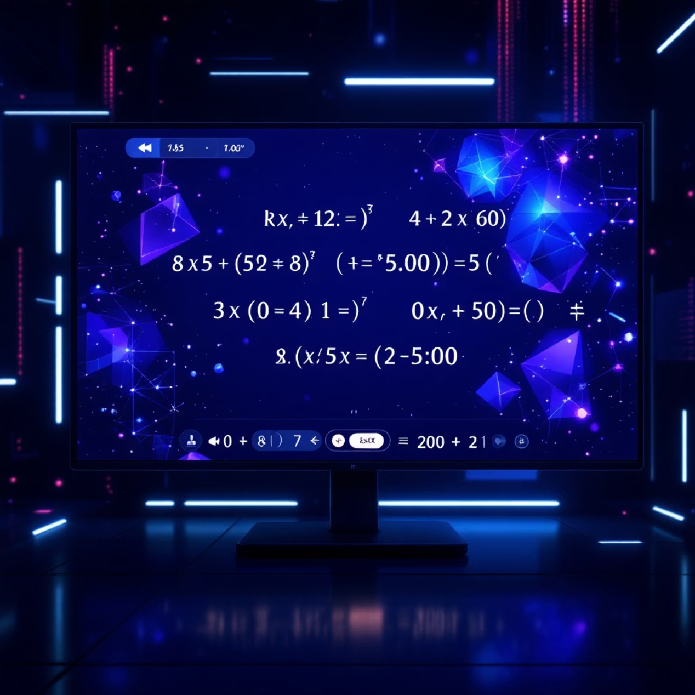
Question Generation System
Adaptive Difficulty
Questions scale based on education level and player progress, ensuring appropriate challenge.
Elementary: Basic arithmetic operations
Middle School: Algebraic equations
High School: Calculus and trigonometry
Real-time validation provides immediate feedback with explanations for learning reinforcement.

Slide 6



Technical Architecture
Python Core
Pygame Framework
Local Storage
Built using Python 3.x for cross-platform compatibility and ease of development.
Handles graphics rendering, user input, and game loop mechanics efficiently.
Saves scores and progress locally with encrypted files for data security.

Slide 7
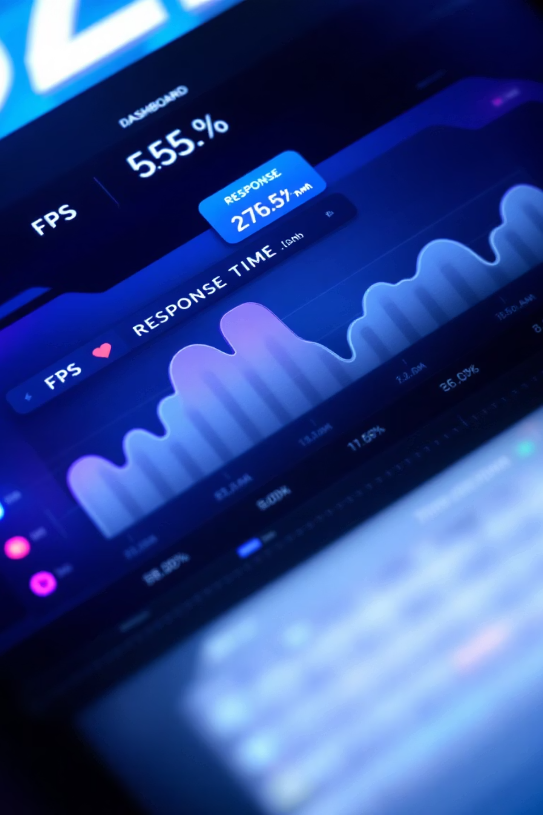
Performance Requirements
60
1
100
FPS Target
Response Time
Question Capacity
Smooth gameplay on standard hardware with consistent frame rates.
Question generation and validation under one second for seamless flow.
Handle up to 100 questions per session without memory issues.

Slide 8



Feasibility Assessment
95%
100%
85%
Technical Feasibility
Economic Feasibility
Schedule Feasibility
Python and Pygame provide robust foundation for game development.
Zero-cost development using free tools and existing hardware resources.
Achievable within semester timeline with proper sprint planning and scope management.

Slide 9
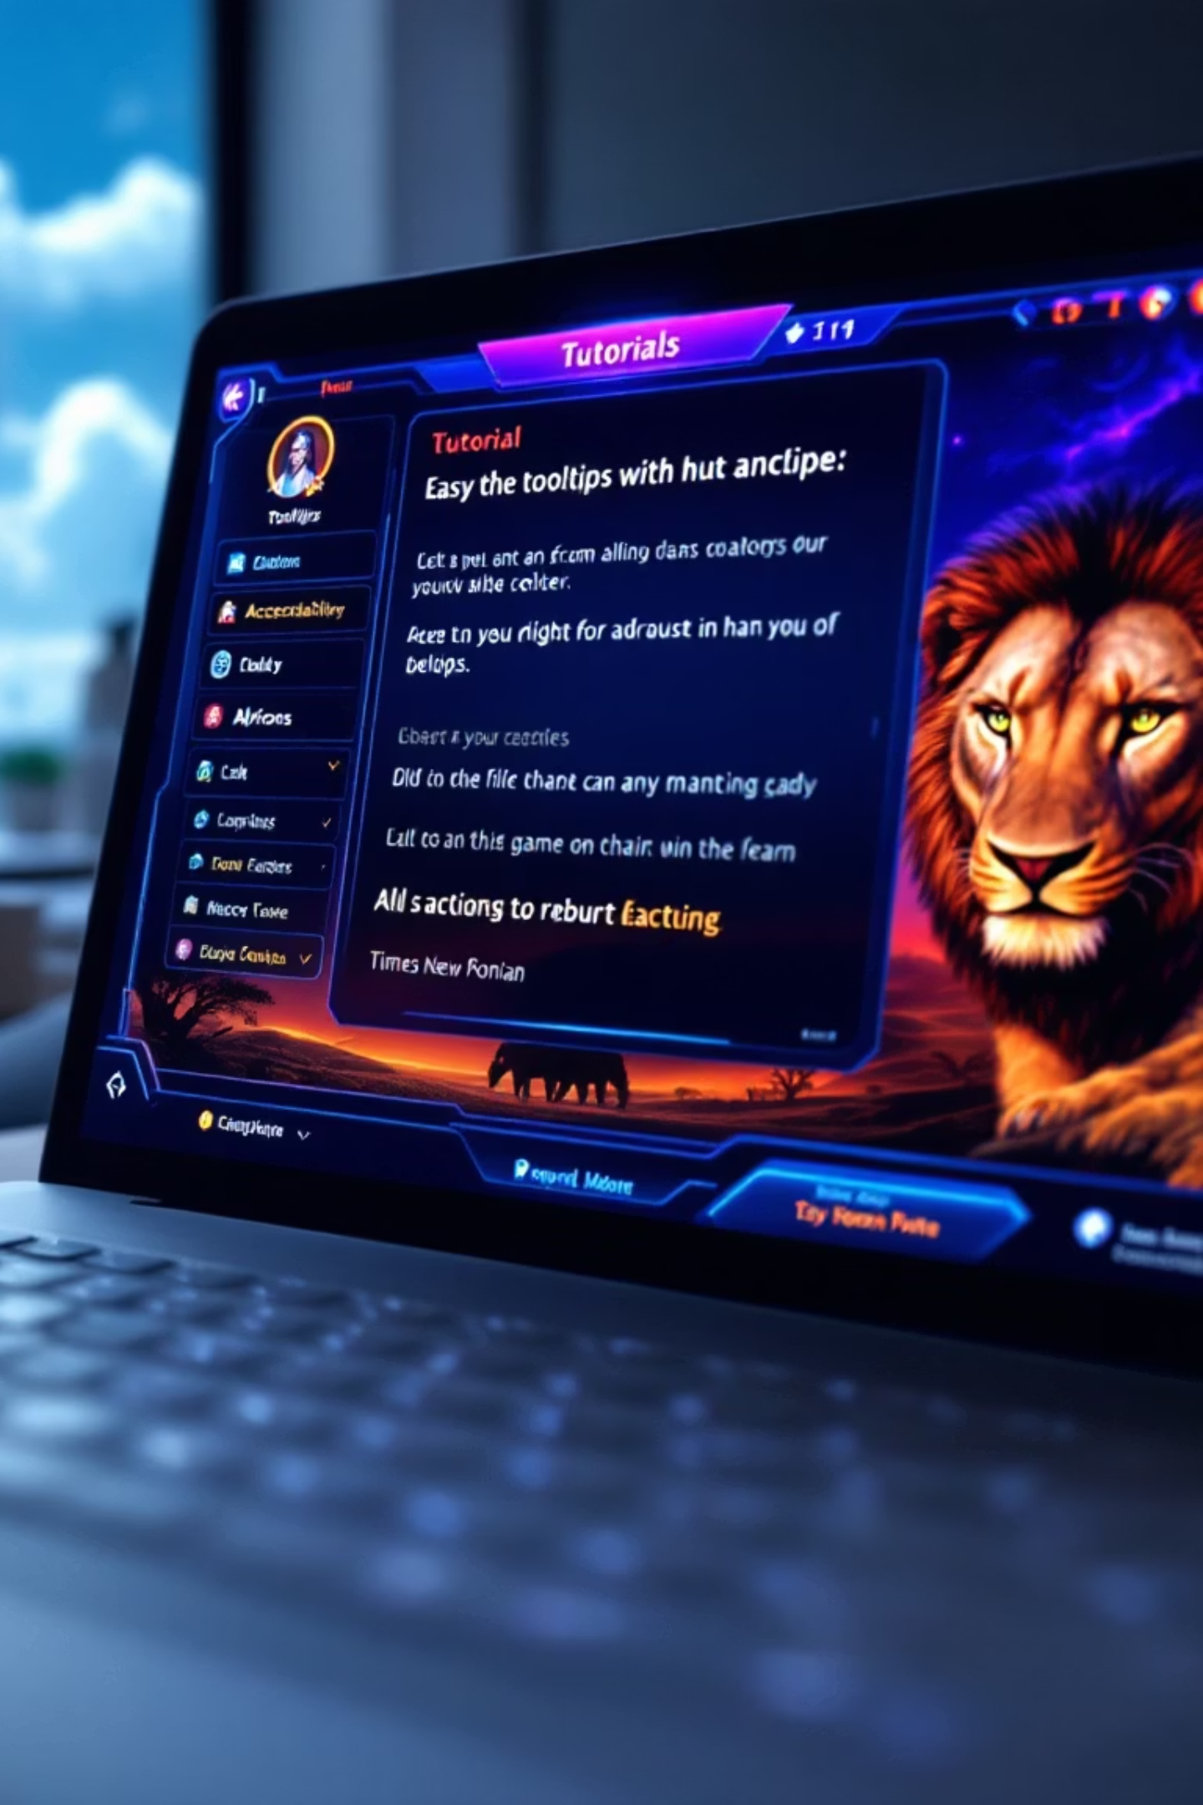
User Experience Design
Intuitive Interface
Tutorial Mode
Clear instructions and responsive controls with keyboard and mouse support for accessibility.
Built-in guidance explaining game mechanics and controls for new players.
Accessibility Features
Color-blind friendly design with high-contrast modes and keyboard-only navigation options.

Slide 10

Project Success Metrics
1
Phase 2 Complete
Requirements specification finalized with stakeholder validation and technical feasibility confirmed.
2
MVP Delivery
Core gameplay mechanics implemented with basic question generation and scoring systems.
3
User Testing
Educational effectiveness validated through student feedback and learning outcome measurements.

